Slide 1
Shadow Play
By David Mimnagh, Michael Fowler & Alastair Louden.

Slide 2
Game Concept
2D puzzle-platformer
Stealth game
Misdirection & Timing
Guard AI-Player interaction
Escape

Slide 3
The Story
After an experiment gone wrong 225 was locked up and forgotten about after developing unstable powers.
Player takes control of experiment 225 after a mysterious stranger let him out his cell.
Must use stealth and wits to get to escape the underground facility he is being kept in.

Slide 4
What has changed?
Game Mechanics
Some initial concepts removed
Controls
Now use mouse to cast the shadow.
Level Creator
Not Creating one, why?

Slide 5
Aspects Removed
Ability to Crouch
Whistling/Knocking
Guard – Guard Interaction
Hiding behind objects

Slide 6
Progress
Trimester 2
Alastair doing images
Code has been optimized
3 levels, all built and tested
Completed Documents
Trimester 1
Placeholders for Images
Badly optimized code
Only 1 level half working
Half way complete Documents

Slide 7
Technologies Used
Windows 7
Microsoft office (PowerPoint, Word)
Google Docs
Microsoft Visual Studio 2013 C++
SFML
TinyXML 2.0
Adobe Illustrator
Bit Bucket / GIT
BASS

Slide 8
Technical Design
The Classes mostly inherit from base classes
Almost all level objects are of type Shape
State Manager allows for easy control of the game
Input Manager for reading the user input, accessed by all States.
Time Management

Slide 9
Game World and Camera
For my section of the work I had to set up a camera and game world.
This was first done using a class when working in SDL.
Late changed to a few line when switching to SFML.
Made a positioning method to make it easier to place objects.

Slide 10
Animations (Code)
For the animations I started by trying to make a class.
I realised I was wasting to much time and found a simpler way of doing the animation.

Slide 11
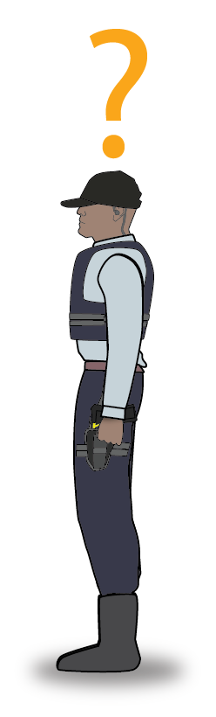

Guard AI and Player/Shadow Interaction
LOLS
WHO DER
Within each level there are Guards
Guards Can be Distracted
Can walk behind them
Required for Progression in the level
Have a set routine.
Patrol, Distracted State, Area Patrol, Return
Will have visual indication of transitioning different stages

Slide 12
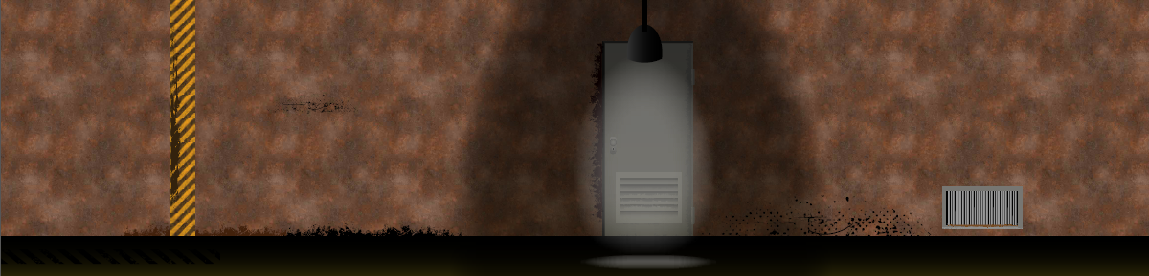
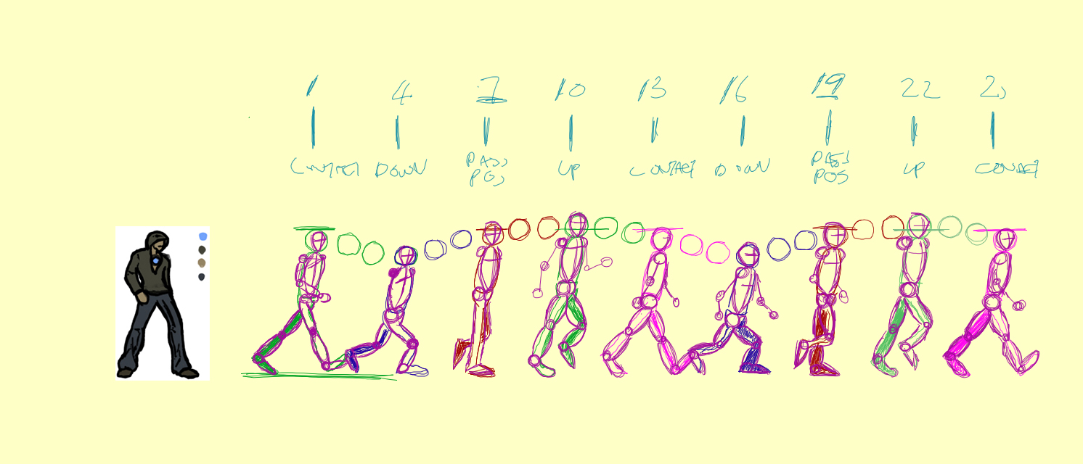
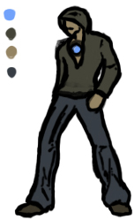
Concept Art

Slide 13
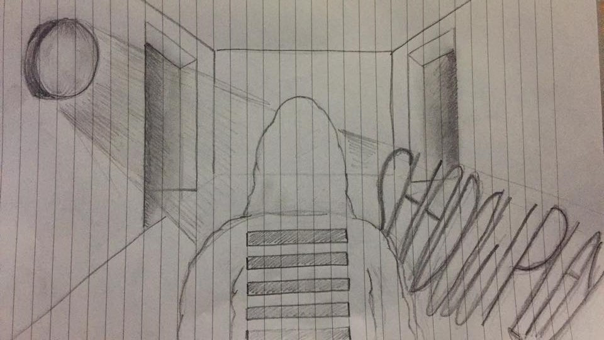
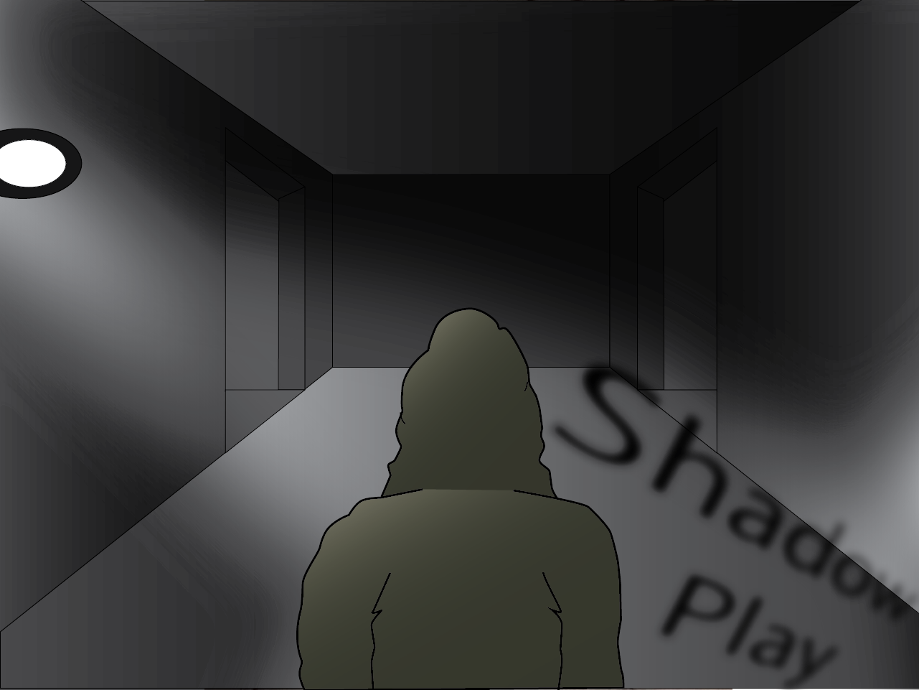
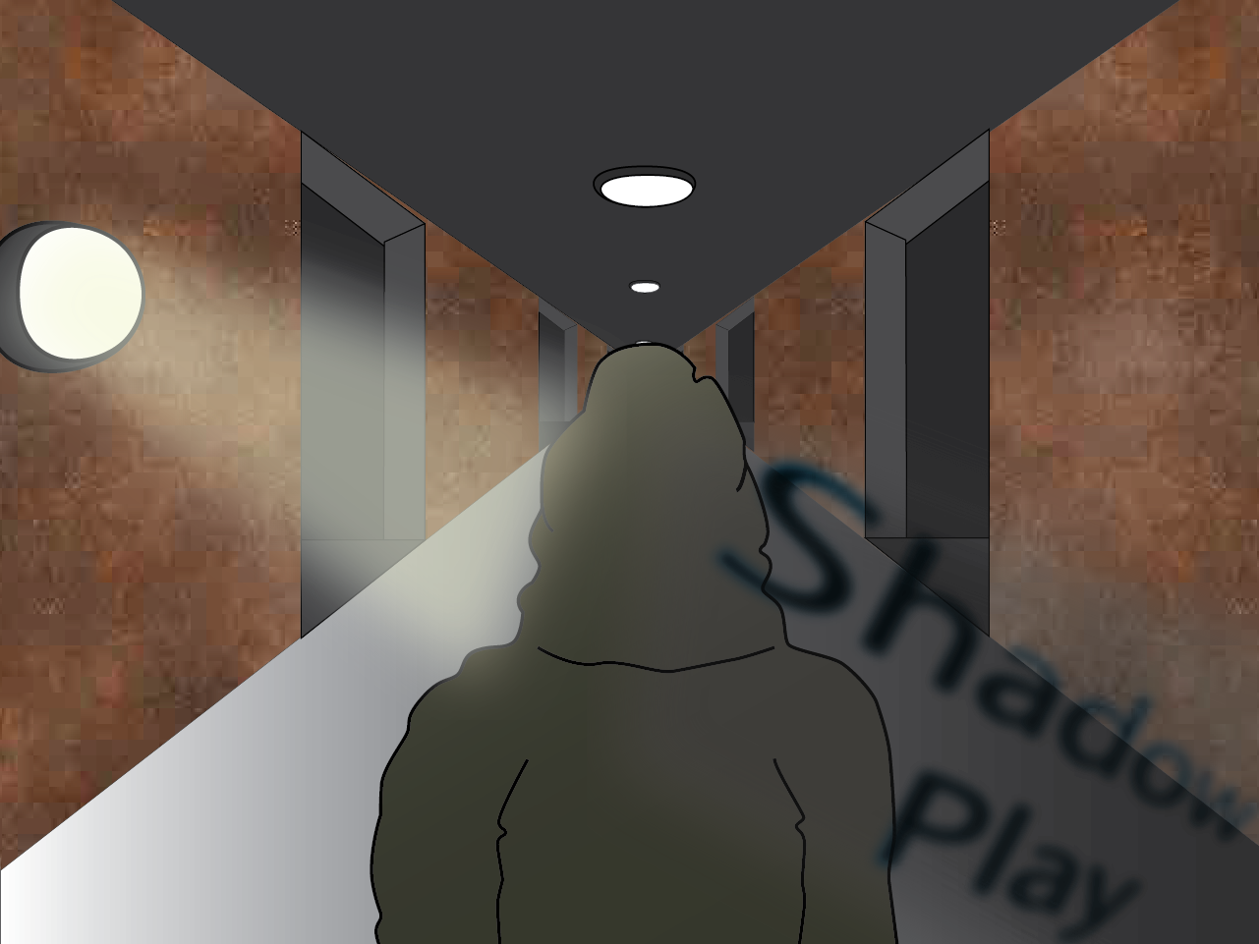

Slide 14
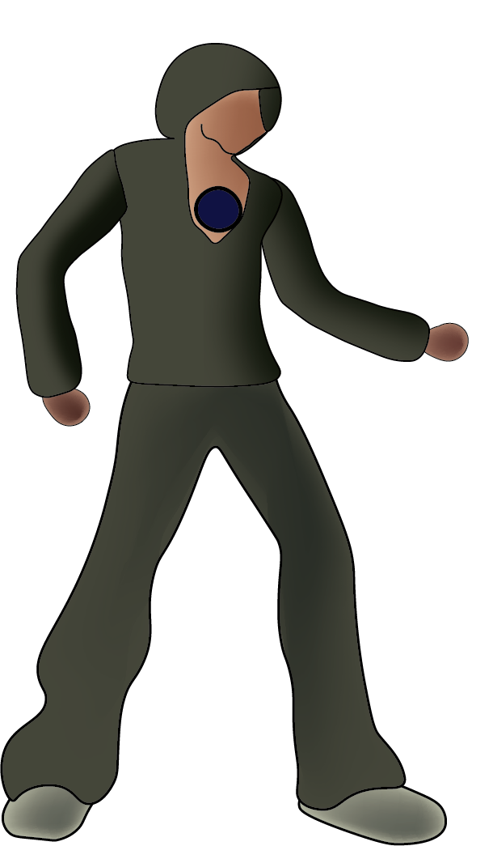
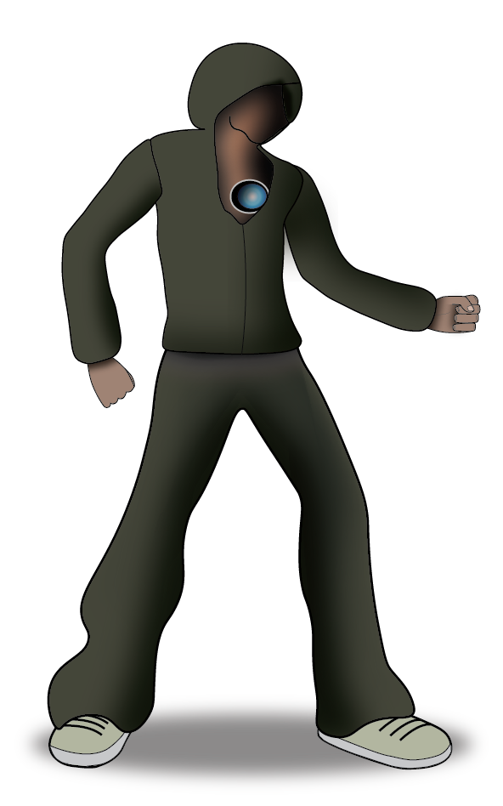
Playable Character
2nd Concept
In Game
In Game
Shadow
Name: Unknown (Experiment No 225)
Inspired By: Zed (League of Legends)

Slide 15
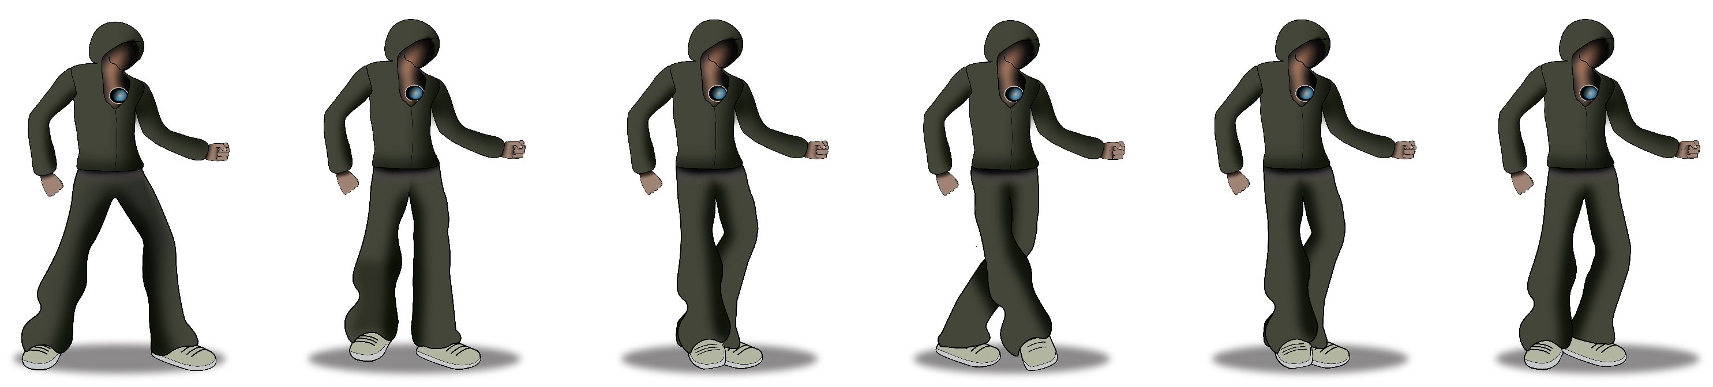
Character Walk Cycle

Slide 16
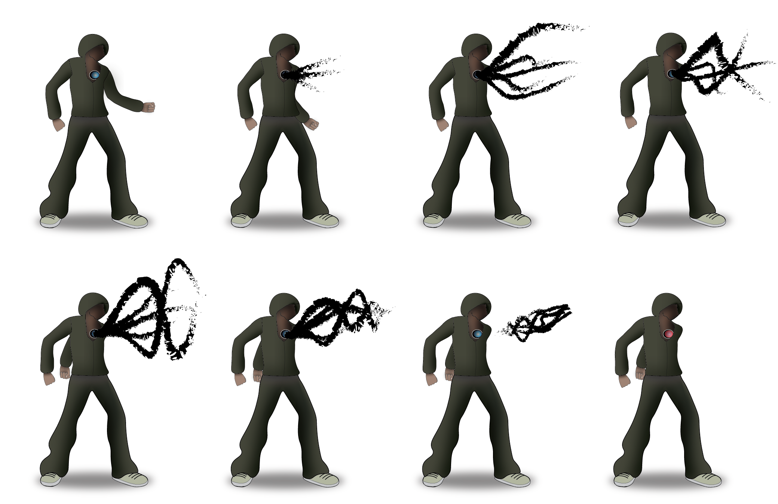
Shadow Projection

Slide 17
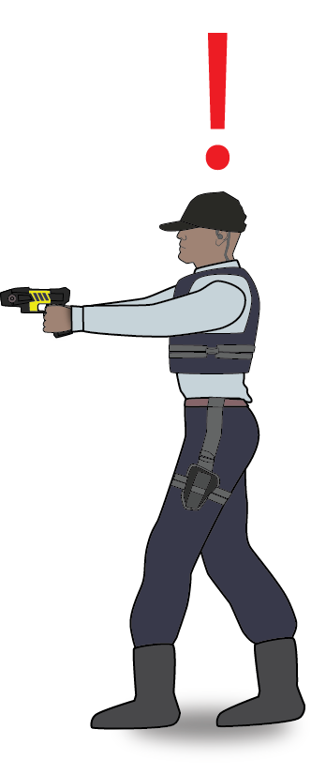
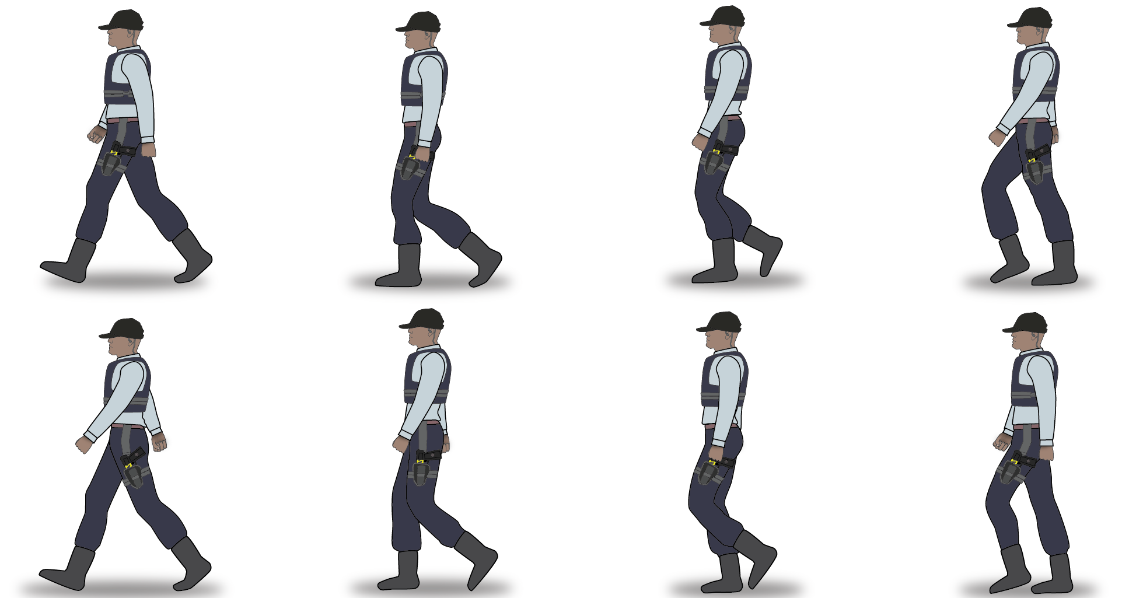
Guard

Slide 18

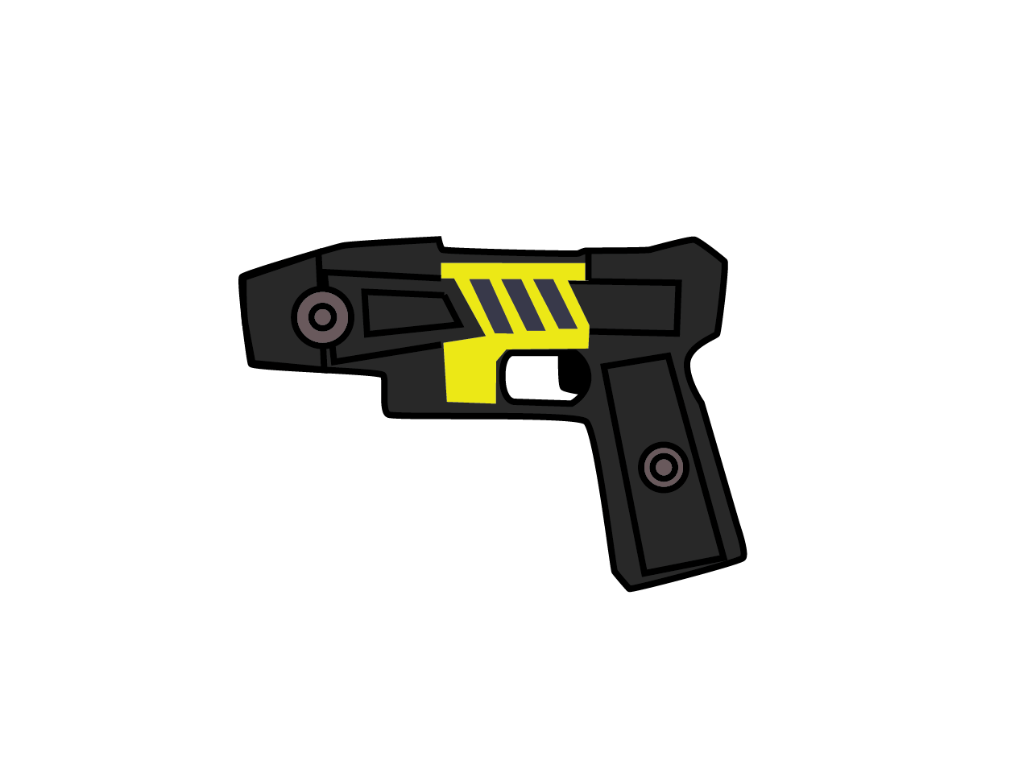
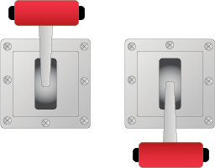

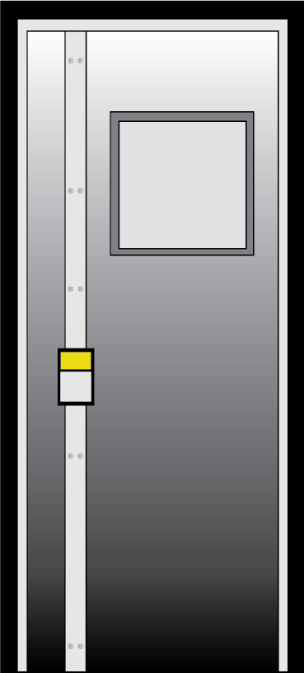
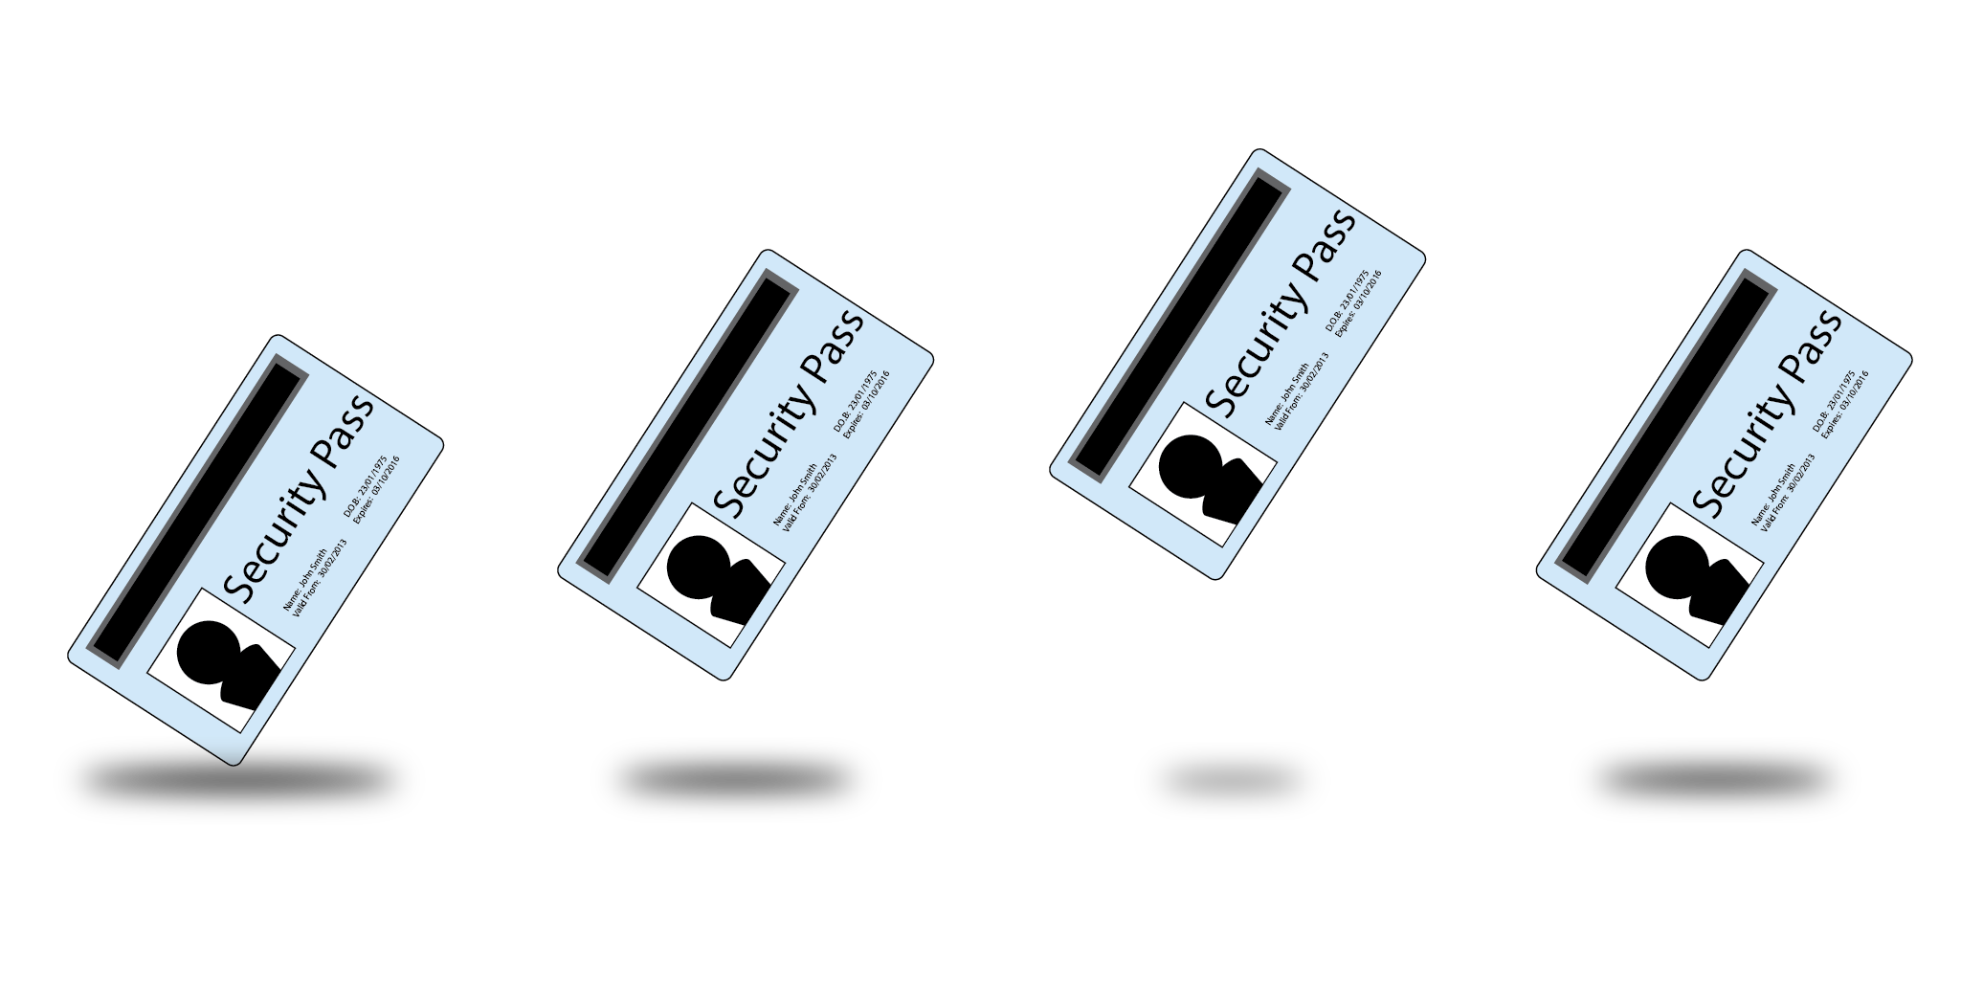
Misc. Items

Slide 19
Lighting and Shadow
Each light is unique.
When entering a light a check is performed to check distance between the lights
Shadow Cool-Down that starts counting after a successful jump has been made.

Slide 20
Overall – The Biggest Challenges faced
Game World and Camera
No real problem as there are loads of tutorials to help.
Switching from SDL to SFML made lots of code redundant no need for a class.
Animations
Trying to use a class to handle the animation that was not needed.
Lighting / Game States in the game
Lights Checking against each other
Assigning Images to Vector Objects

Slide 21
Overall – The Biggest Challenges faced
Guard Ai and Player/Shadow Interaction
Logic Based - Keeping Track of Variables
Implementing Code – Shadow
Make the Game playable with AI
Time Constraints
Graphics = 1 less programmer
Graphics
Unreliable outside Source
New Software
No 2d background

Slide 22
What we could have done differently!
Do the graphics ourselves
Better Version Control from beginning
Better Planning

Slide 23
Still to be done for next week?
Source/Make more audio for the game
Make sure all levels are playable, but yet challenging.
Finish all of the graphics.

Slide 24
Live DEMO
By David ☺

Slide 25
Questions ? Thanks For Listening!

